Slide 1
ALY 6070 Final Project Customer Churn Analysis
By Nithin Reddy
Presented to : Dr. Harpreet Sharma Date: 25/03/24

Slide 2
Dataset Selection Rationale
The data set is about a Californian Telecom company consisting of 7,043 observations with 33 columns, taken from Kaggle.
Comprehensive: The chosen dataset offers a wide array of customer demographic, service usage, and contract details within the telecommunications industry.
Analytical Potential: Its richness allows for in-depth analyses to identify primary drivers of customer churn.
Actionable Insights: By leveraging this dataset, we aim to derive actionable insights to mitigate churn and bolster business stability.

Slide 3
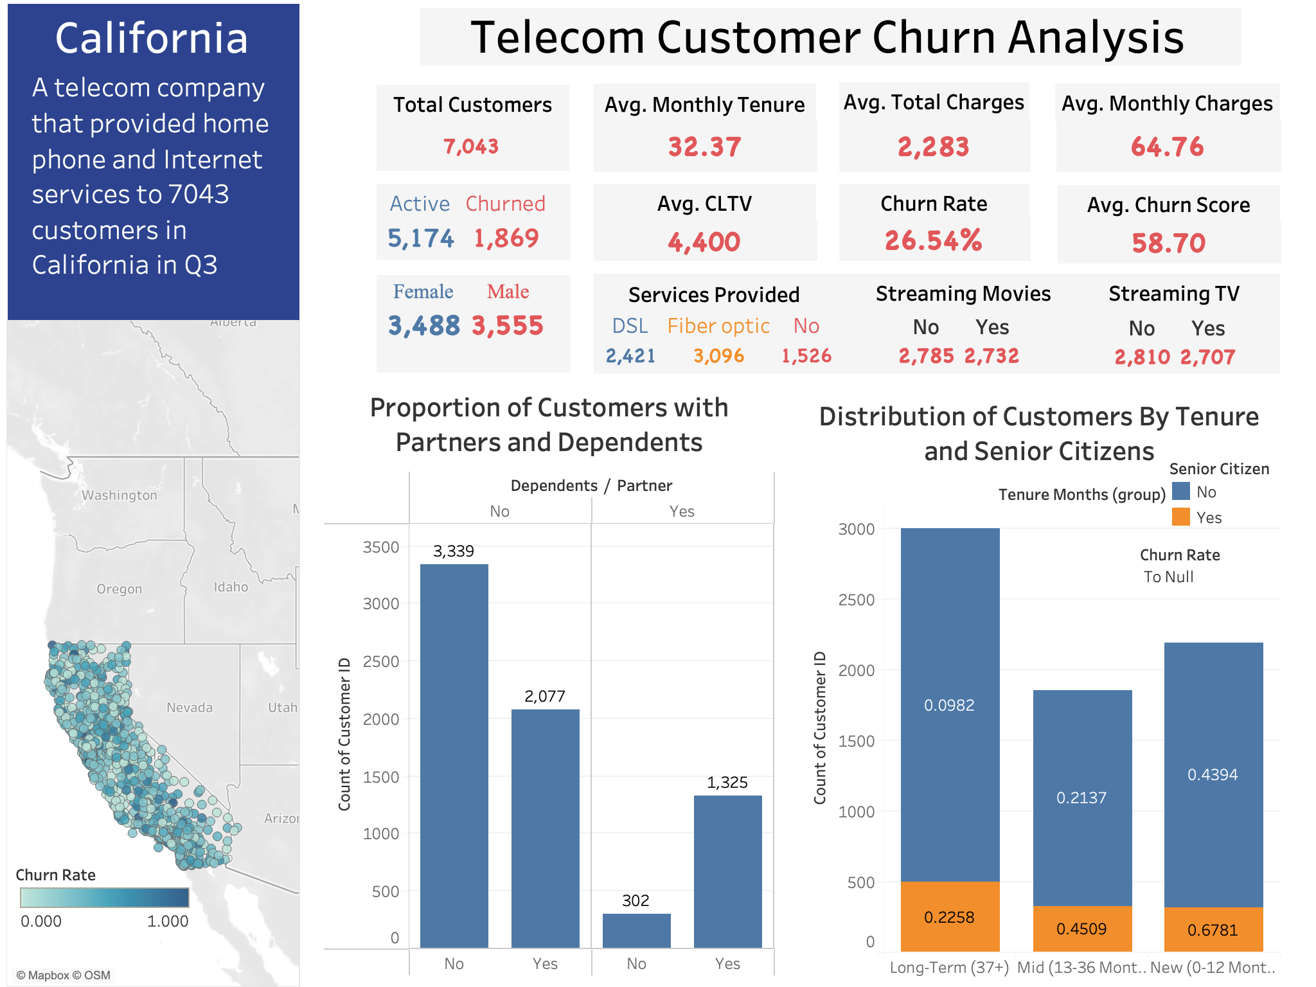

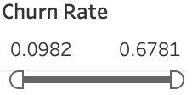
An analytics of a telecom provider's customer engagement in California, showcasing service distribution, churn trends, and customer tenure for targeted business strategy development.

Slide 4
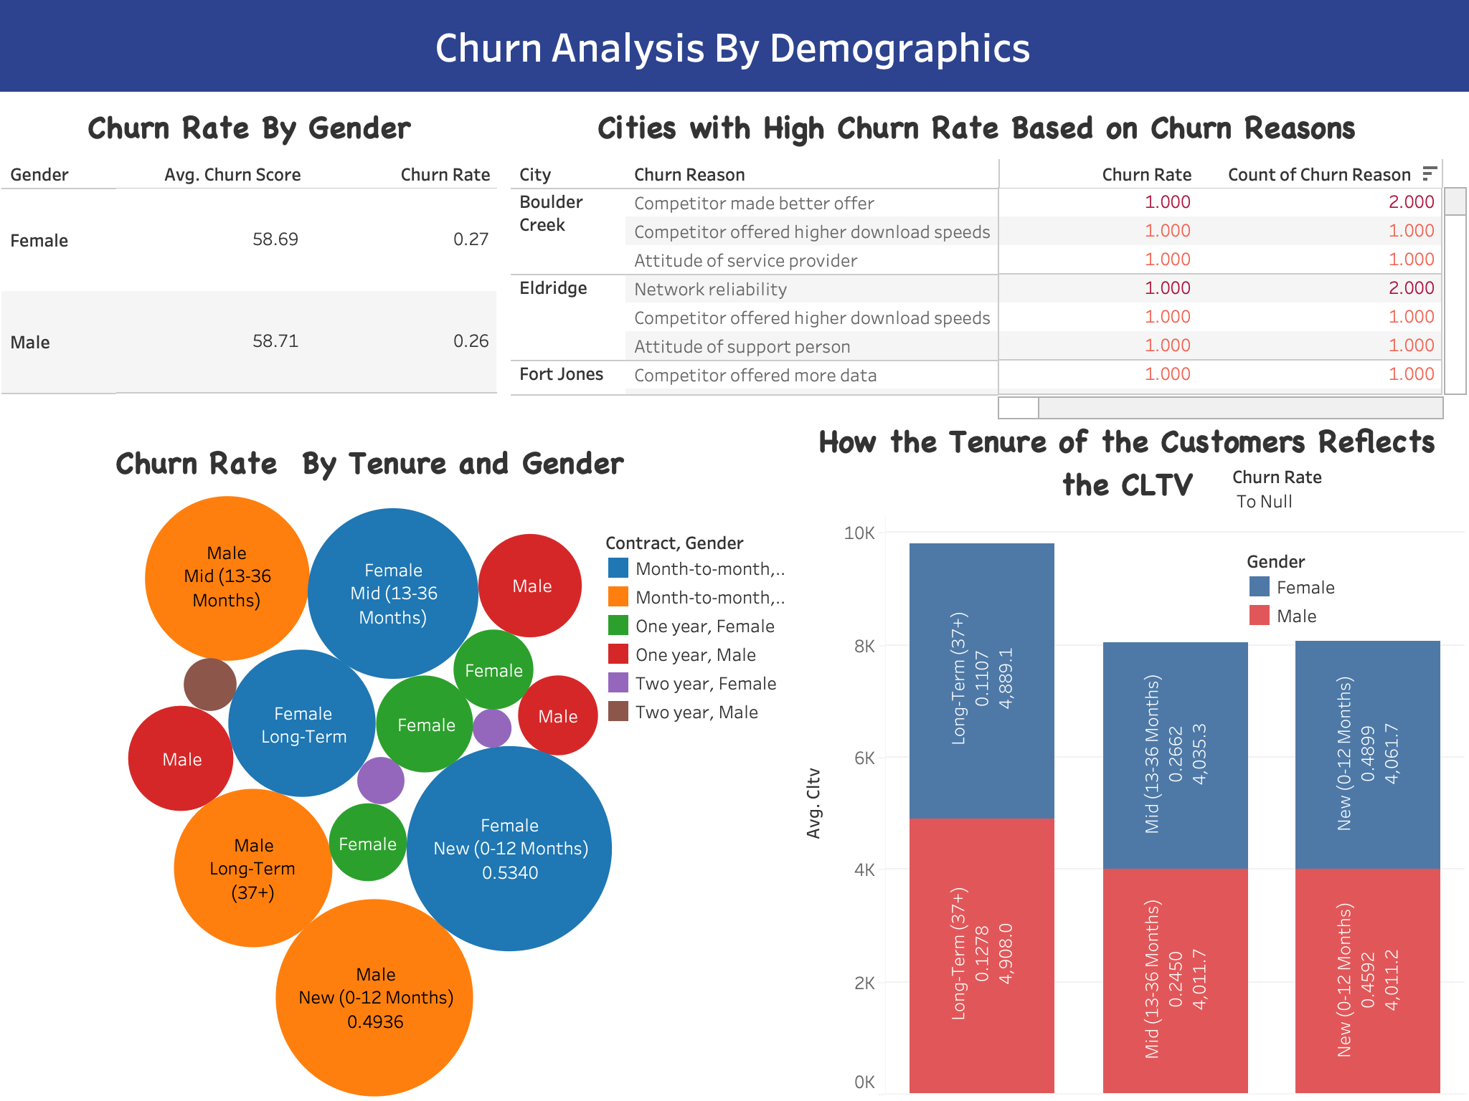
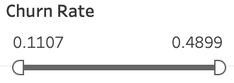
Gender and tenure-based churn insights paired with CLTV trends, spotlighting demographic influences on customer retention

Slide 5
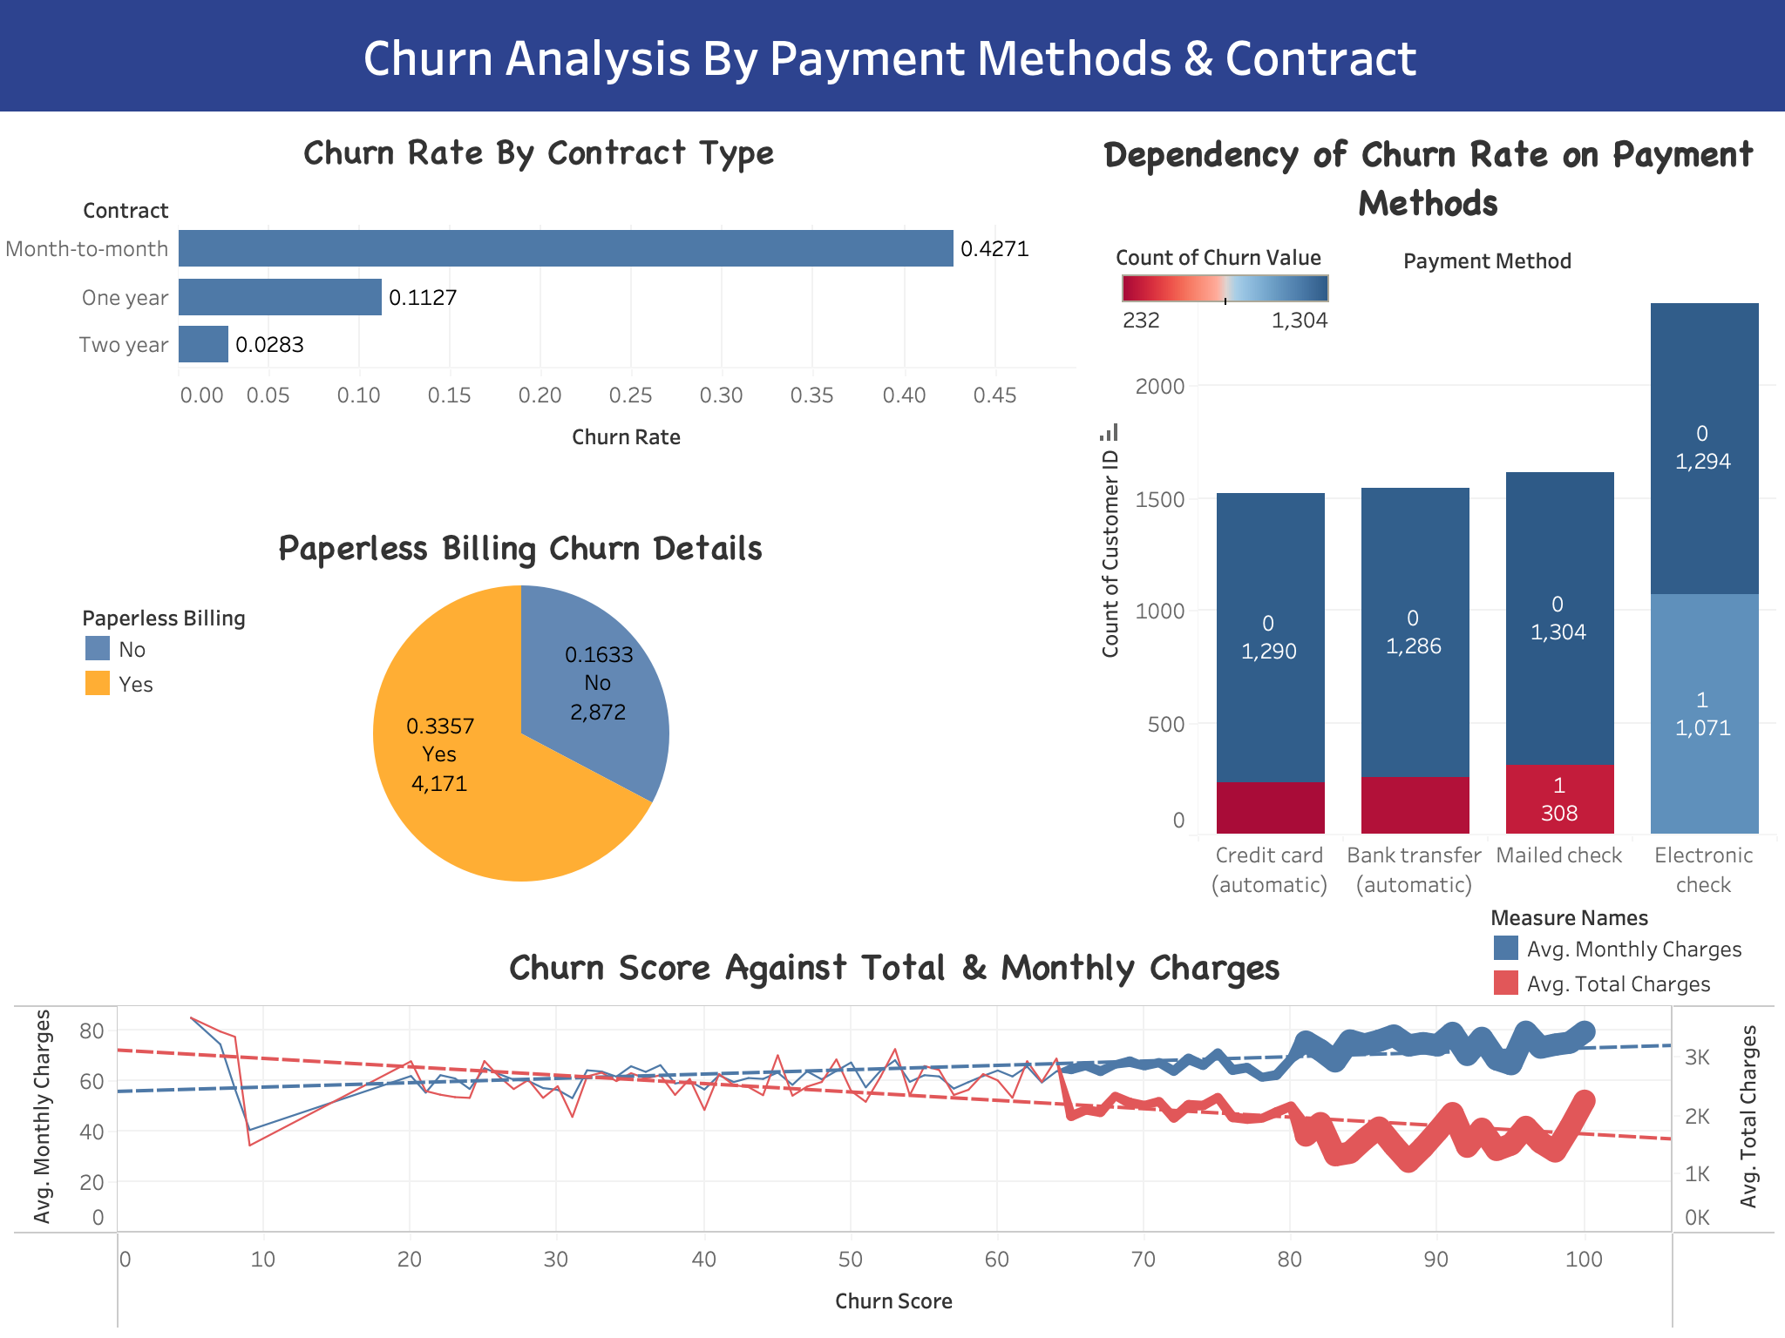
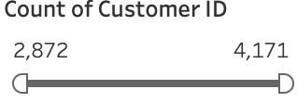
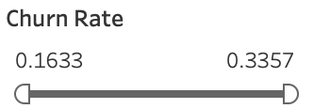
Analyzing customer turnover by contract types and payment methods, and how billing choices relate to customer loyalty and charges.

Slide 6
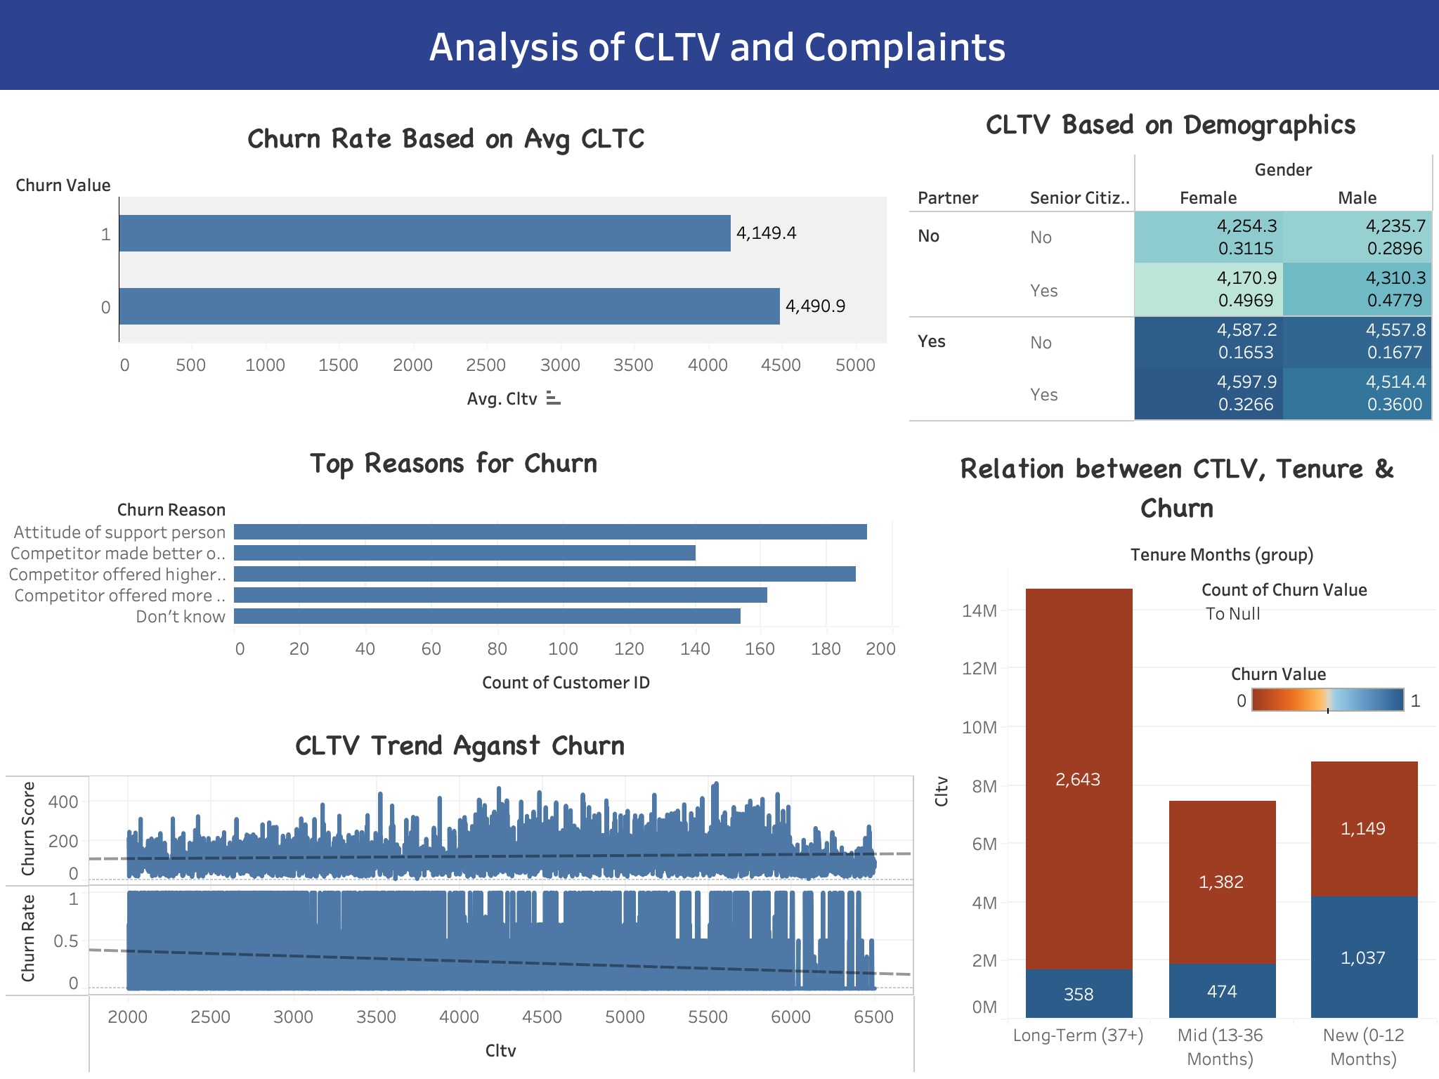
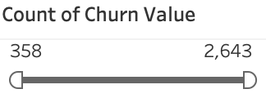
Breaking down the connection between customer value, loyalty, and demographics through telecom churn and CLTV analysis.

Slide 7
Findings & Recommendations
Churn Analysis by Demographics:
Churn Insights: Churn rates are slightly higher among female customers, and churn reasons across cities suggest competitive offers and service features are key factors.
Churn by Tenure and Gender: Longer tenure customers show lower churn rates, highlighting the value of customer retention over time.
CLTV and Tenure: There's a clear trend that longer customer tenure correlates with higher CLTV, emphasizing the financial benefit of nurturing long-term customer relationships.
Recommendations:
Strategic Focus: To reduce churn by addressing competitive gaps and improving service features, especially for newer customers.
Retention Value: Reinforce the importance of fostering long-term relationships as they translate into higher customer value
Analyzing Payment Methods and Churn Rates:
Churn Rate by Contract Type:
Finding: Month-to-month contracts exhibit the highest churn rate, followed by one-year contracts and two-year contracts.
Recommendation: Encourage customers to opt for longer-term contracts by offering incentives such as discounts or additional services.
Paperless Billing Churn Details:
Finding: Customers with paperless billing have a higher churn rate compared to those receiving paper bills.
Recommendation: Analyze the reasons behind the higher churn rate among paperless billing customers and consider offering incentives to retain them.
Dependency of Churn Rate on Payment Methods:
Finding: Customers using electronic checks and mailed checks exhibit higher churn rates.
Recommendation: Investigate the reasons behind the dissatisfaction associated with these payment methods and consider optimizing the payment experience to improve customer retention.

Slide 8
Findings & Recommendations
Leveraging CLTV Insights and Demographic Analysis
Churn Rate Based on Average CLTV:
Finding: Customers who churn have a lower average CLTV compared to retained customers.
Recommendation: Focus retention efforts on high CLTV customers by providing personalized offers or enhanced services to increase their loyalty.
CLTV Based on Demographics:
Finding: CLTV varies across demographic segments such as Partner, Senior Citizen status, and Gender.
Recommendation: Tailor retention strategies based on demographic insights to address the specific needs and preferences of different customer groups.
Top Reasons for Churn:
Finding: Identified the primary factors driving customer churn within the company.
Recommendation: Address the root causes of churn by implementing targeted initiatives such as improving product/service quality, enhancing customer support, or offering loyalty programs.
Relationship between CLTV, Tenure, and Churn:
Finding: Customers with longer tenure tend to have higher CLTV, indicating the importance of building long-term relationships.
Recommendation: Implement retention strategies aimed at fostering customer loyalty over time, such as providing exclusive benefits to long-standing customers.
CLTV Trend Against Churn:
Finding: CLTV correlates with churn rate and churn score, providing insights into customer retention behavior.
Recommendation: Use CLTV trends to refine churn prediction models and proactively intervene with targeted retention efforts for customers at risk of churn.

Slide 9

Thank You

